Slide 1
STOCK PRICE MODELING
ASIA KOUSAR
TOM DANNER

Slide 2
AGENDA
Project Goal
Model Introduction
Results
Let's Do Some Coding!
Takeaways & Next Steps
Q&A

Slide 3
PROJECT GOAL
Predict stock prices in ‘x’ number of days by combining multiple models.

Slide 4
MODELS USED
Random Forest
Gradient Boost
X Gradient Boost
Linear Regression
Ridge
Stacking Regressor
Voting Regressor

Slide 5
RANDOM FOREST
RF Regression models use bagging (bootstrap aggregating) to split the data into subsets then independently train multiple decision trees.
Final decision made using majority voting.
Notes:
Model averaging

Slide 6
GRADIENT BOOST
GB models use Boosting to combine multiple ‘weak learners’ within a model to create one strong model. This is done by calculating a loss function while training multiple decision trees sequentially.
Notes:
Loss function with weak learners

Slide 7
X GRADIENT BOOST
The main difference between GB and XGB:
XGB incorporates L1 & L2 Regularization, these functions account for outliers and weights to measure the model's complexity to reduce loss.

Slide 8
LINEAR REGRESSION
LR models predict a Dependent variable based on its linear relationship to Independent variables.
The goal is to reduce the sum of squared errors

Slide 9
RIDGE
The main difference between LR and Ridge:
Ridge incorporates L2 Regularization, this function accounts for outliers and weights to measure the model's complexity to reduce loss.

Slide 10

STACKING MODELS
Fit many different models into same dataset
make final predictions through meta learner

Slide 11
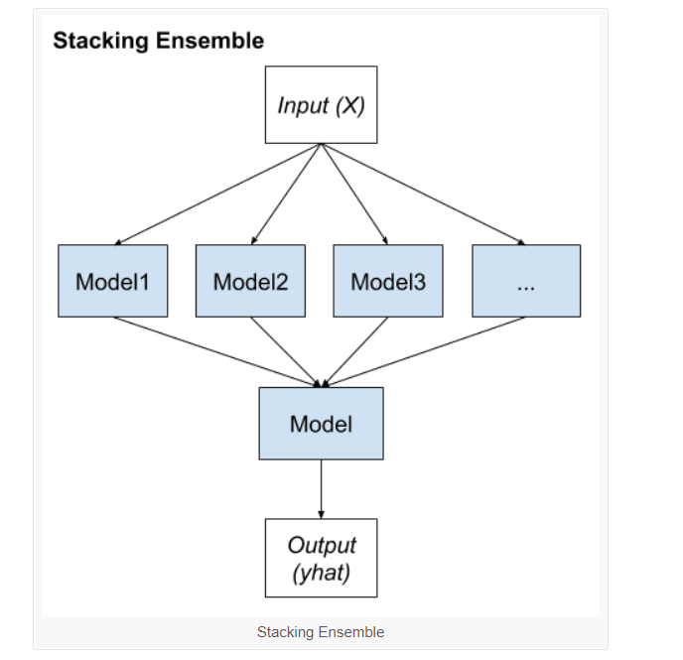
STACKING MODELS

Slide 12
VOTING REGRESSOR
For regression models:
makes a prediction that is the average of multiple regression models.
For classification models:
uses hard voting or soft voting

Slide 13
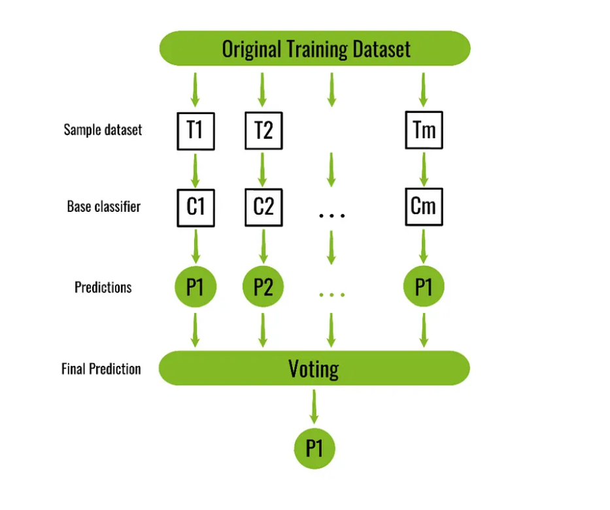
VOTING REGRESSOR

Slide 14
MODEL ENSEMBLING
PROS:
Reduces hidden biases by combining multiple models
Mitigates the risk of misclassification by adjusting the week learners
CONS:
One size doesn't fit all
increased cost of training and implementation

Slide 15
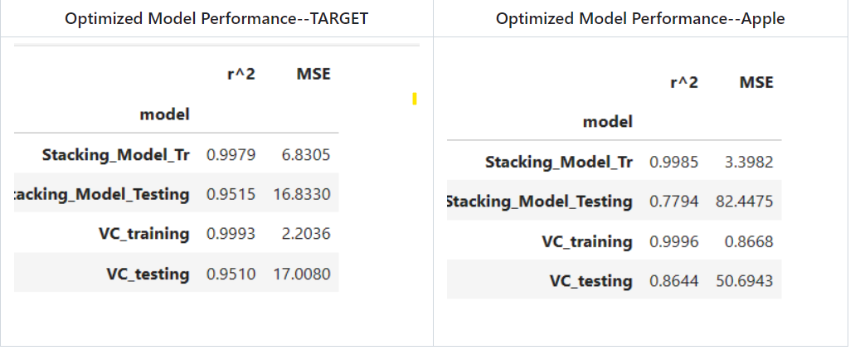
Optimized Model Validation

Slide 16
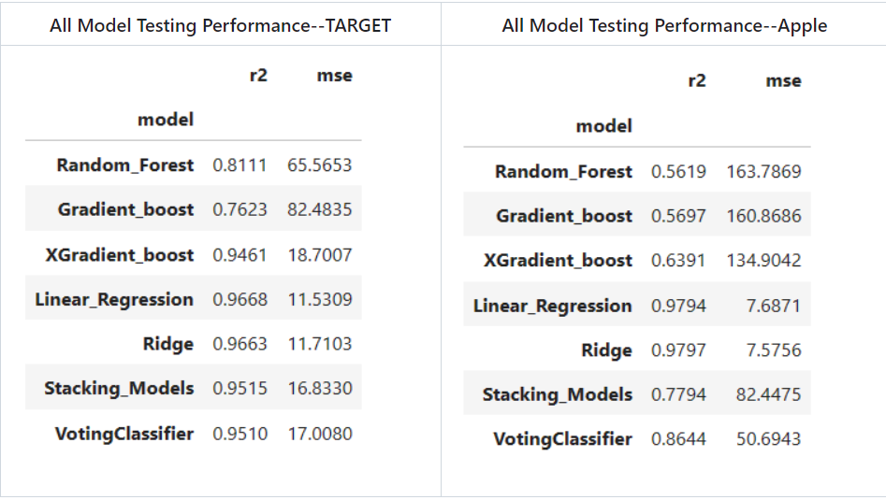
All Models Performance Report

Slide 17
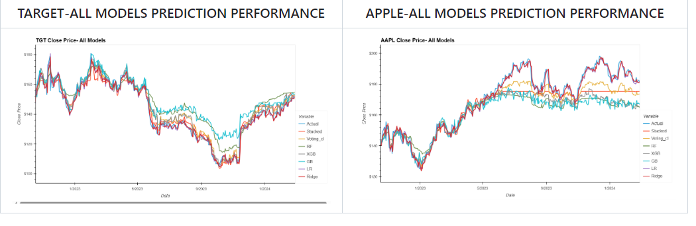
Model Predictions

Slide 18
CODING

Slide 19
TAKEAWAYS & NEXT STEPS
Increase the amount of refining using Grid Search
Create a Neural Network LSTM Model
Further research into why our models are unable to predict large moving stocks (find specific indicators). Can we improve this?
Notes:
Long-Short Term Model

Slide 20
Q&A

Slide 21
THANK YOU!

